Slide 1
AWS Global Infrastructure
Module 3: AWS Global Infrastructure Overview
Notes:
Introducing Section 1: AWS Global Infrastructure.

Slide 2
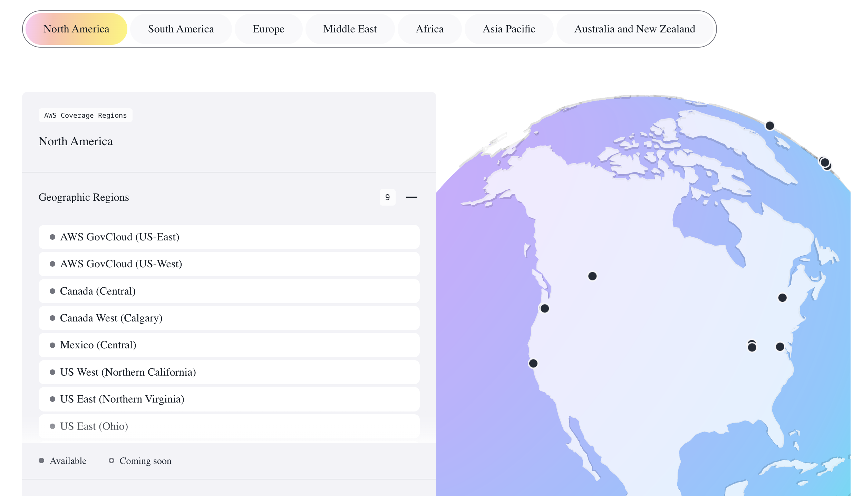
AWS Global Infrastructure
The AWS Global Infrastructure is designed and built to deliver a flexible, reliable, scalable, and secure cloud computing environment with high-quality global network performance.
https://aws.amazon.com/about-aws/global-infrastructure/#AWS_Global_Infrastructure_Map
Notes:
To learn more about the AWS Regions that are currently available, use one of the following links:
https://aws.amazon.com/about-aws/global-infrastructure/#AWS_Global_Infrastructure_Map
https://aws.amazon.com/about-aws/global-infrastructure/regions_az/
These resources are updated frequently to show current and planned AWS infrastructure.

Slide 3
Infrastructure Organization
You Choose
AWS Region
Availability Zones (2-3)
Data Centers
You Pick #
AWS Chooses

Slide 4
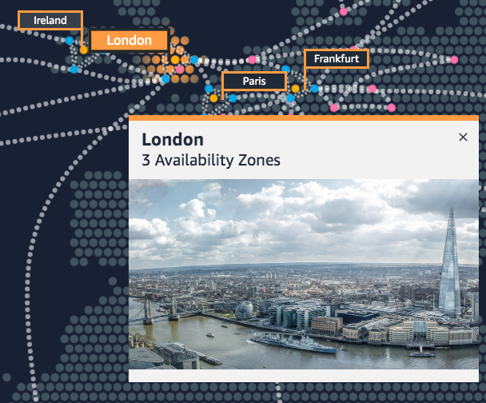
AWS Regions
An AWS Region is a geographical area.
Data replication across Regions is controlled by you.
Communication between Regions uses AWS backbone network infrastructure.
Each Region provides full redundancy and connectivity to the network.
A Region typically consists of two or more Availability Zones.
Example: London Region
Notes:
The AWS Cloud infrastructure is built around Regions. AWS has 22 Regions worldwide. An AWS Region is a physical geographical location with one or more Availability Zones. Availability Zones in turn consist of one or more data centers.
To achieve fault tolerance and stability, Regions are isolated from one another. Resources in one Region are not automatically replicated to other Regions. When you store data in a specific Region, it is not replicated outside that Region.
It is your responsibility to replicate data across Regions, if your business needs require it.
AWS Regions that were introduced before March 20, 2019 are enabled by default. Regions that were introduced after March 20, 2019—such as Asia Pacific (Hong Kong) and Middle East (Bahrain)—are disabled by default. You must enable these Regions before you can use them. You can use the AWS Management Console to enable or disable a Region.
Some Regions have restricted access. An Amazon AWS (China) account provides access to the Beijing and Ningxia Regions only. To learn more about AWS in China, see: https://www.amazonaws.cn/en/about-aws/china/. The isolated AWS GovCloud (US) Region is designed to allow US government agencies and customers to move sensitive workloads into the cloud by addressing their specific regulatory and compliance requirements.
For accessibility: Snapshot from the infrastructure.aws website that shows a picture of downtown London including the Tower Bridge and the Shard. It notes that there are three Availability Zones in the London region. End of accessibility description.

Slide 5
Selecting a Region
Data governance, legal requirements
Proximity to customers (latency)
Determine the right Region for your services, applications, and data based on these factors
Services available within the Region
Costs (vary by Region)
Notes:
There are a few factors that you should consider when you select the optimal Region or Regions where you store data and use AWS services.
One essential consideration is data governance and legal requirements. Local laws might require that certain information be kept within geographical boundaries. Such laws might restrict the Regions where you can offer content or services. For example, consider the European Union (EU) Data Protection Directive.
All else being equal, it is generally desirable to run your applications and store your data in a Region that is as close as possible to the user and systems that will access them. This will help you reduce latency. CloudPing is one website that you can use to test latency between your location and all AWS Regions. To learn more about CloudPing, see: http://www.cloudping.info/
Keep in mind that not all services are available in all Regions. To learn more, see: https://aws.amazon.com/about-aws/global-infrastructure/regional-product-services/?p=tgi&loc=4.
Finally, there is some variation in the cost of running services, which can depend on which Region you choose. For example, as of this writing, running an On-Demand t3.medium size Amazon Elastic Compute Cloud (Amazon EC2) Linux instance in the US East (Ohio) Region costs $0.0416 per hour, but running the same instance in the Asia Pacific (Tokyo) Region costs $0.0544 per hour.

Slide 6



Availability Zones
Each Region has multiple Availability Zones.
Each Availability Zone is a fully isolated partition of the AWS infrastructure.
Availability Zones consist of discrete data centers
They are designed for fault isolation
They are interconnected with other Availability Zones by using high-speed private networking
You choose your Availability Zones.
AWS recommends replicating data and resources across Availability Zones for resiliency.
AWS Cloud
Region eu-west-1
Availability Zone eu-west-1a
Data center
Data center
Data center
Availability Zone eu-west-1b
Availability Zone eu-west-1c
Notes:
Each AWS Region has multiple, isolated locations that are known as Availability Zones.
Each Availability Zone provides the ability to operate applications and databases that are more highly available, fault-tolerant, and scalable than would be possible with a single data center. Each Availability Zone can include multiple data centers (typically three), and at full-scale, they can include hundreds of thousands of servers. They are fully isolated partitions of the AWS Global Infrastructure. Availability Zones have their own power infrastructure, and they are physically separated by many kilometers from other Availability Zones—though all Availability Zones are within 100 km of each other.
All Availability Zones are interconnected with high-bandwidth, low-latency networking over fully redundant, dedicated fiber that provides high-throughput between Availability Zones. The network accomplishes synchronous replication between Availability Zones.
Availability Zones help build highly available applications. When an application is partitioned across Availability Zones, companies are better isolated and protected from issues such as lightning, tornadoes, earthquakes, and more.
You are responsible for selecting the Availability Zones where your systems will reside. Systems can span multiple Availability Zones. AWS recommends replicating across Availability Zones for resiliency. You should design your systems to survive the temporary or prolonged failure of an Availability Zone if a disaster occurs.

Slide 7

AWS data centers
AWS data centers are designed for security.
Data centers are where the data resides and data processing occurs.
Each data center has redundant power, networking, and connectivity, and is housed in a separate facility.
A data center typically has 50,000 to 80,000 physical servers.
Notes:
The foundation for the AWS infrastructure is the data centers. Customers do not specify a data center for the deployment of resources. Instead, an Availability Zone is the most granular level of specification that a customer can make. However, a data center is the location where the actual data resides. Amazon operates state-of-the-art, highly available data centers. Although rare, failures can occur that affect the availability of instances in the same location. If you host all your instances in a single location that is affected by such a failure, none of your instances will be available.
Data centers are securely designed with several factors in mind:
Each location is carefully evaluated to mitigate environmental risk.
Data centers have a redundant design that anticipates and tolerates failure while maintaining service levels.
To ensure availability, critical system components are backed up across multiple Availability Zones.
To ensure capacity, AWS continuously monitors service usage to deploy infrastructure to support availability commitments and requirements.
Data center locations are not disclosed and all access to them is restricted.
In case of failure, automated processes move data traffic away from the affected area.
AWS uses custom network equipment sourced from multiple original device manufacturers (ODMs). ODMs design and manufacture products based on specifications from a second company. The second company then rebrands the products for sale.

Slide 8
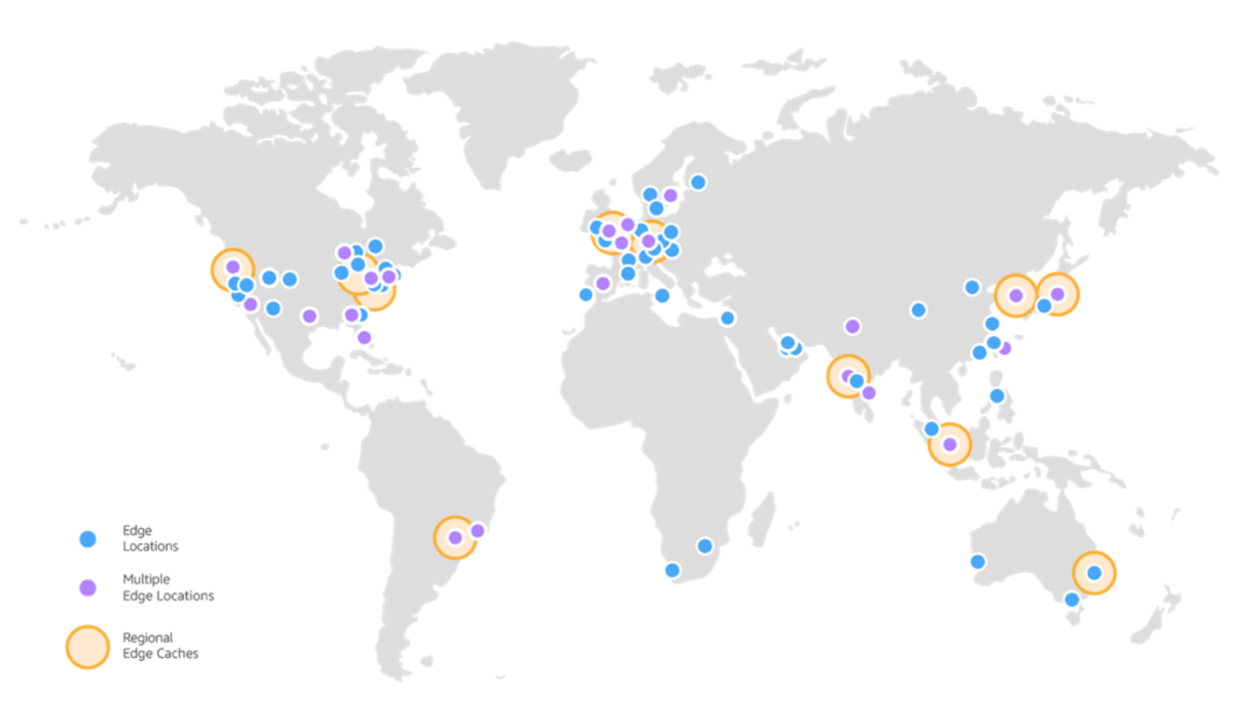
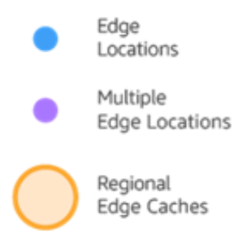
Points of Presence
AWS provides a global network of Points of Presence locations
Consists of edge locations and a much smaller number of Regional edge caches
Used with Amazon CloudFront
A global Content Delivery Network (CDN), that delivers content to end users with reduced latency
Regional edge caches used for content with infrequent access.
Notes:
Amazon CloudFront is a content delivery network (CDN) used to distribute content to end users to reduce latency. Amazon Route 53 is a Domain Name System (DNS) service. Requests going to either one of these services will be routed to the nearest edge location automatically in order to lower latency.
AWS Points of Presence are located in most of the major cities around the world. By continuously measuring internet connectivity, performance and computing to find the best way to route requests, the Points of Presence deliver a better near real-time user experience. They are used by many AWS services, including Amazon CloudFront, Amazon Route 53, AWS Shield, and AWS Web Application Firewall (AWS WAF) services.
Regional edge caches are used by default with Amazon CloudFront. Regional edge caches are used when you have content that is not accessed frequently enough to remain in an edge location. Regional edge caches absorb this content and provide an alternative to that content having to be fetched from the origin server.

Slide 9




AWS infrastructure features
Elasticity and scalability
Elastic infrastructure; dynamic adaption of capacity
Scalable infrastructure; adapts to accommodate growth
Fault-tolerance
Continues operating properly in the presence of a failure
Built-in redundancy of components
High availability
High level of operational performance
Minimized downtime
No human intervention
Physically distinct
Backup generators
Data center
Data center
Data center
Data center
Data center
Data center
Data center
Data center
Availability Zone
Availability Zone
Network connectivity
Data center
Data center
Data center
Data center
Availability Zone
Uninterruptible power supply
Cooling equipment
AWS Region
Notes:
Now that you have a good understanding of the major components that comprise the AWS Global Infrastructure, let's consider the benefits provided by this infrastructure.
The AWS Global Infrastructure has several valuable features:
First, it is elastic and scalable. This means resources can dynamically adjust to increases or decreases in capacity requirements. It can also rapidly adjust to accommodate growth.
Second, this infrastructure is fault tolerant, which means it has built-in component redundancy which enables it to continue operations despite a failed component.
Finally, it requires minimal to no human intervention, while providing high availability with minimal down time.

Slide 10
Domains of Cloud Computing
Computing
Storage
Data
Microservices / Cloud Functions
Virtual Machines
Application Hosting
Containers
Blob storage
Redundant and localized storage
Container orchestration
Data storage
Data analytics
Data ingestion & pipelines

Slide 11























AWS categories of services
Analytics
Application
Integration
AR and VR
Blockchain
Business Applications
Compute
Cost Management
Customer Engagement
Database
Developer Tools
End User
Computing
Game Tech
Internet of Things
Machine Learning
Management and Governance
Media Services
Migration and
Transfer
Mobile
Networking and
Content Delivery
Robotics
Satellite
Security, Identity, and Compliance
Storage
Notes:
AWS offers a broad set of cloud-based services. There are 23 different product or service categories, and each category consists of one or more services. This course will not attempt to introduce you to each service. Rather, the focus of this course is on the services that are most widely used and offer the best introduction to the AWS Cloud. This course also focuses on services that are more likely to be covered in the AWS Certified Cloud Practitioner exam.
The categories that this course will discuss are highlighted on the slide: Compute, Cost Management, Database, Management and Governance, Networking and Content Delivery, Security, Identity, and Compliance, and Storage.
To learn more about AWS products, see Cloud Products at https://aws.amazon.com/products/. All AWS products are organized into the service categories that are shown here. For example, if you click Compute, you will see that Amazon Elastic Compute Cloud (Amazon EC2) is first on the list. The compute category also lists many other products and services.
If you click Amazon EC2, it takes you to the Amazon EC2 page. Each product page provides a detailed description of the product and lists some of its benefits.
Explore the different service groups to understand the categories and services within them. Now that you know how to locate information about different services, this module will discuss the highlighted service categories. The next seven slides list the individual services —within each of the categories highlighted above—that this course will discuss.

Slide 12




Storage service category
AWS storage services
Amazon Simple Storage Service (Amazon S3)
Amazon Elastic Block Store (Amazon EBS)
Amazon Elastic File System (Amazon EFS)
Photo from https://www.pexels.com/photo/black-and-grey-device-159282/
Amazon Simple Storage Service Glacier
Notes:
AWS storage services include the services listed here, and many others.
Amazon Simple Storage Service (Amazon S3) is an object storage service that offers scalability, data availability, security, and performance. Use it to store and protect any amount of data for websites, mobile apps, backup and restore, archive, enterprise applications, Internet of Things (IoT) devices, and big data analytics.
Amazon Elastic Block Store (Amazon EBS) is high-performance block storage that is designed for use with Amazon EC2 for both throughput and transaction intensive workloads. It is used for a broad range of workloads, such as relational and non-relational databases, enterprise applications, containerized applications, big data analytics engines, file systems, and media workflows.
Amazon Elastic File System (Amazon EFS) provides a scalable, fully managed elastic Network File System (NFS) file system for use with AWS Cloud services and on-premises resources. It is built to scale on demand to petabytes, growing and shrinking automatically as you add and remove files. It reduces the need to provision and manage capacity to accommodate growth.
Amazon Simple Storage Service Glacier is a secure, durable, and extremely low-cost Amazon S3 cloud storage class for data archiving and long-term backup. It is designed to deliver 11 9s of durability, and to provide comprehensive security and compliance capabilities to meet stringent regulatory requirements.

Slide 13








Compute service category
AWS Compute services
Amazon EC2
Amazon EC2 Auto Scaling
Amazon Elastic Container Service (Amazon ECS)
Amazon EC2 Container Registry
Photo from https://www.pexels.com/photo/technology-computer-lines-board-50711/
AWS Elastic Beanstalk
AWS Lambda
Amazon Elastic Kubernetes Service (Amazon EKS)
AWS Fargate
Notes:
AWS compute services include the services listed here, and many others.
Amazon Elastic Compute Cloud (Amazon EC2) provides resizable compute capacity as virtual machines in the cloud.
Amazon EC2 Auto Scaling enables you to automatically add or remove EC2 instances according to conditions that you define.
Amazon Elastic Container Service (Amazon ECS) is a highly scalable, high-performance container orchestration service that supports Docker containers.
Amazon Elastic Container Registry (Amazon ECR) is a fully-managed Docker container registry that makes it easy for developers to store, manage, and deploy Docker container images.
AWS Elastic Beanstalk is a service for deploying and scaling web applications and services on familiar servers such as Apache and Microsoft Internet Information Services (IIS).
AWS Lambda enables you to run code without provisioning or managing servers. You pay only for the compute time that you consume. There is no charge when your code is not running.
Amazon Elastic Kubernetes Service (Amazon EKS) makes it easy to deploy, manage, and scale containerized applications that use Kubernetes on AWS.
AWS Fargate is a compute engine for Amazon ECS that allows you to run containers without having to manage servers or clusters.

Slide 14




Database service category
AWS Database services
Amazon Relational Database Service
Amazon Aurora
Amazon Redshift
Amazon DynamoDB
Photo from https://aws.amazon.com/compliance/data-center/data-centers/
Notes:
AWS database services include the services listed here, and many others.
Amazon Relational Database Service (Amazon RDS) makes it easy to set up, operate, and scale a relational database in the cloud. It provides resizable capacity while automating time-consuming administration tasks such as hardware provisioning, database setup, patching, and backups.
Amazon Aurora is a MySQL and PostgreSQL-compatible relational database. It is up to five times faster than standard MySQL databases and three times faster than standard PostgreSQL databases.
Amazon Redshift enables you to run analytic queries against petabytes of data that is stored locally in Amazon Redshift, and directly against exabytes of data that are stored in Amazon S3. It delivers fast performance at any scale.
Amazon DynamoDB is a key-value and document database that delivers single-digit millisecond performance at any scale, with built-in security, backup and restore, and in-memory caching.

Slide 15







Networking and content delivery service category
AWS networking and content delivery services
Amazon VPC
Elastic Load Balancing
Amazon CloudFront
AWS Transit
Gateway
Amazon Route 53
AWS Direct Connect
AWS VPN
Photo by Umberto on Unsplash
Notes:
AWS networking and content delivery services include the services listed here, and many others.
Amazon Virtual Private Cloud (Amazon VPC) enables you to provision logically isolated sections of the AWS Cloud.
Elastic Load Balancing automatically distributes incoming application traffic across multiple targets, such as Amazon EC2 instances, containers, IP addresses, and Lambda functions.
Amazon CloudFront is a fast content delivery network (CDN) service that securely delivers data, videos, applications, and application programming interfaces (APIs) to customers globally, with low latency and high transfer speeds.
AWS Transit Gateway is a service that enables customers to connect their Amazon Virtual Private Clouds (VPCs) and their on-premises networks to a single gateway.
Amazon Route 53 is a scalable cloud Domain Name System (DNS) web service designed to give you a reliable way to route end users to internet applications. It translates names (like www.example.com) into the numeric IP addresses (like 192.0.2.1) that computers use to connect to each other.
AWS Direct Connect provides a way to establish a dedicated private network connection from your data center or office to AWS, which can reduce network costs and increase bandwidth throughput.
AWS VPN provides a secure private tunnel from your network or device to the AWS global network.

Slide 16







Security, identity, and compliance service category
AWS security, identity, and compliance services
AWS Identity and Access Management (IAM)
AWS Organizations
Amazon Cognito
Photo by Paweł Czerwiński on Unsplash
AWS Artifact
AWS Key
Management Service
AWS Shield
Notes:
AWS security, identity, and compliance services include the services listed here, and many others.
AWS Identity and Access Management (IAM) enables you to manage access to AWS services and resources securely. By using IAM, you can create and manage AWS users and groups. You can use IAM permissions to allow and deny user and group access to AWS resources.
AWS Organizations allows you to restrict what services and actions are allowed in your accounts.
Amazon Cognito lets you add user sign-up, sign-in, and access control to your web and mobile apps.
AWS Artifact provides on-demand access to AWS security and compliance reports and select online agreements.
AWS Key Management Service (AWS KMS) enables you to create and manage keys. You can use AWS KMS to control the use of encryption across a wide range of AWS services and in your applications.
AWS Shield is a managed Distributed Denial of Service (DDoS) protection service that safeguards applications running on AWS.

Slide 17




AWS cost management service category
AWS cost management services
AWS Cost and
Usage Report
AWS Budgets
AWS Cost
Explorer
Photo by Alexander Mils on Unsplash
Notes:
AWS cost management services include the services listed here, and others.
The AWS Cost and Usage Report contains the most comprehensive set of AWS cost and usage data available, including additional metadata about AWS services, pricing, and reservations.
AWS Budgets enables you to set custom budgets that alert you when your costs or usage exceed (or are forecasted to exceed) your budgeted amount.
AWS Cost Explorer has an easy-to-use interface that enables you to visualize, understand, and manage your AWS costs and usage over time.

Slide 18









Management and governance service category
AWS management and
governance services
AWS Management Console
AWS Config
Amazon CloudWatch
AWS Auto Scaling
Photo by Marta Branco from Pexels
AWS Command
Line Interface
AWS Trusted
Advisor
AWS Well- Architected Tool
AWS
CloudTrail
Notes:
AWS management and governance services include the services listed here, and others.
The AWS Management Console provides a web-based user interface for accessing your AWS account.
AWS Config provides a service that helps you track resource inventory and changes.
Amazon CloudWatch allows you to monitor resources and applications.
AWS Auto Scaling provides features that allow you to scale multiple resources to meet demand.
AWS Command Line Interface provides a unified tool to manage AWS services.
AWS Trusted Advisor helps you optimize performance and security.
AWS Well-Architected Tool provides help in reviewing and improving your workloads.
AWS CloudTrail tracks user activity and API usage.

Slide 19
Module 4: AWS Cloud Security
AWS Academy Cloud Foundations
Notes:
Welcome to Module 4: AWS Cloud Security.
Security is the highest priority at Amazon Web Services (AWS). AWS delivers a scalable cloud computing environment that is designed for high availability and dependability, while providing the tools that enable you to run a wide range of applications. Helping to protect the confidentiality, integrity, and availability of your systems and data is critical to AWS, and so is maintaining customer trust and confidence. This module provides an introduction to the AWS approach to security, which includes both the controls in the AWS environment and some of the AWS products and features customers can use to meet their security objectives.

Slide 20
AWS shared responsibility model
Module 4: AWS Cloud Security
Notes:
Introducing Section 1: AWS shared responsibility model.

Slide 21
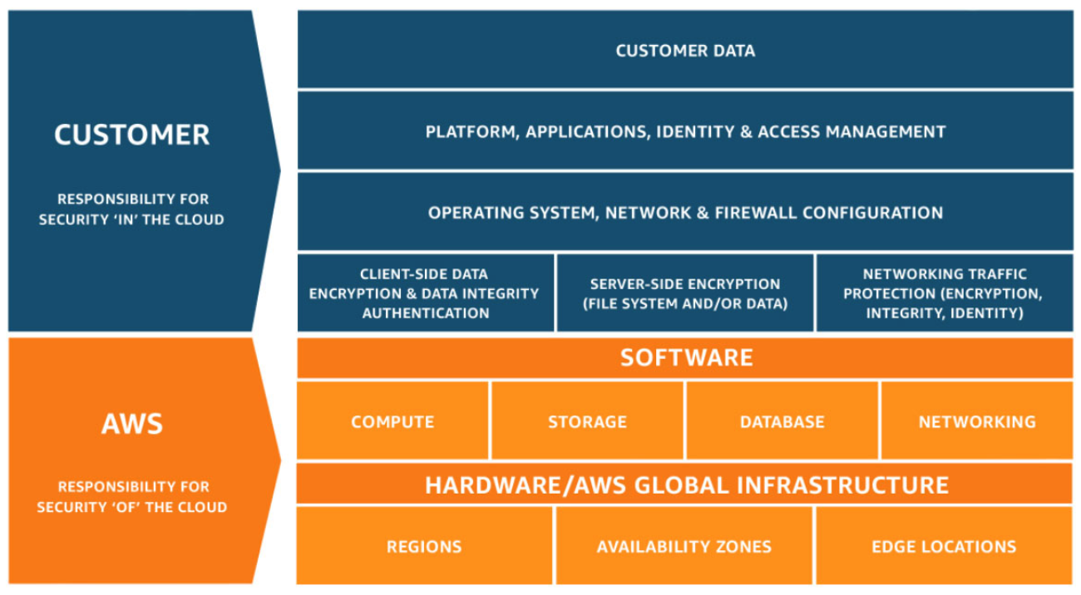
AWS shared responsibility model
Notes:
Security and compliance are a shared responsibility between AWS and the customer. This shared responsibility model is designed to help relieve the customer’s operational burden. At the same time, to provide the flexibility and customer control that enables the deployment of customer solutions on AWS, the customer remains responsible for some aspects of the overall security. The differentiation of who is responsible for what is commonly referred to as security “of” the cloud versus security “in” the cloud.
AWS operates, manages, and controls the components from the software virtualization layer down to the physical security of the facilities where AWS services operate. AWS is responsible for protecting the infrastructure that runs all the services that are offered in the AWS Cloud. This infrastructure is composed of the hardware, software, networking, and facilities that run the AWS Cloud services.
The customer is responsible for the encryption of data at rest and data in transit. The customer should also ensure that the network is configured for security and that security credentials and logins are managed safely. Additionally, the customer is responsible for the configuration of security groups and the configuration of the operating system that run on compute instances that they launch (including updates and security patches).

Slide 22



AWS responsibility: Security of the cloud
AWS responsibilities:
Physical security of data centers
Controlled, need-based access
Hardware and software infrastructure
Storage decommissioning, host operating system (OS) access logging, and auditing
Network infrastructure
Intrusion detection
Virtualization infrastructure
Instance isolation
AWS services
Compute
Storage
Database
Networking
AWS Global Infrastructure
Regions
Availability Zones
Edge locations
Notes:
AWS is responsible for security of the cloud. But what does that mean?
Under the AWS shared responsibility model, AWS operates, manages, and controls the components from the bare metal host operating system and hypervisor virtualization layer down to the physical security of the facilities where the services operate. It means that AWS is responsible for protecting the global infrastructure that runs all the services that are offered in the AWS Cloud. The global infrastructure includes AWS Regions, Availability Zones, and edge locations.
AWS is responsible for the physical infrastructure that hosts your resources, including:
Physical security of data centers with controlled, need-based access; located in nondescript facilities, with 24/7 security guards; two-factor authentication; access logging and review; video surveillance; and disk degaussing and destruction.
Hardware infrastructure, such as servers, storage devices, and other appliances that AWS relies on.
Software infrastructure, which hosts operating systems, service applications, and virtualization software.
Network infrastructure, such as routers, switches, load balancers, firewalls, and cabling. AWS also continuously monitors the network at external boundaries, secures access points, and provides redundant infrastructure with intrusion detection.
Protecting this infrastructure is the top priority for AWS. While you cannot visit AWS data centers or offices to see this protection firsthand, Amazon provides several reports from third-party auditors who have verified our compliance with a variety of computer security standards and regulations.

Slide 23
Customer responsibility: Security in the cloud
Customer responsibilities:
Amazon Elastic Compute Cloud (Amazon EC2) instance operating system
Including patching, maintenance
Applications
Passwords, role-based access, etc.
Security group configuration
OS or host-based firewalls
Including intrusion detection or prevention systems
Network configurations
Account management
Login and permission settings for each user
Customer data
Applications, IAM
Operating system, network, and firewall configuration
Client-side data
encryption and data integrity authentication
Server-side encryption
(file system or data)
Network traffic protection
(encryption, integrity, identity)
Customer-configurable
Notes:
While the cloud infrastructure is secured and maintained by AWS, customers are responsible for security of everything they put in the cloud.
The customer is responsible for what is implemented by using AWS services and for the applications that are connected to AWS. The security steps that you must take depend on the services that you use and the complexity of your system.
Customer responsibilities include selecting and securing any instance operating systems, securing the applications that are launched on AWS resources, security group configurations, firewall configurations, network configurations, and secure account management.
When customers use AWS services, they maintain complete control over their content. Customers are responsible for managing critical content security requirements, including:
What content they choose to store on AWS
Which AWS services are used with the content
In what country that content is stored
The format and structure of that content and whether it is masked, anonymized, or encrypted
Who has access to that content and how those access rights are granted, managed, and revoked
Customers retain control of what security they choose to implement to protect their own data, environment, applications, IAM configurations, and operating systems.

Slide 24
Cautionary Tale: Cloud Storage Security
Turkey's Pegasus Airlines "gave away" 6.5Tb of sensitive data
"An AWS S3 bucket containing Pegasus Airlines' Electronic Flight Bag (EFB) information was left without password protection, leaking a range of sensitive flight data,"
"PegasusEFB's open bucket left data in more than 23 million files accessible to anyone, while also exposing EFB software's source code, which contained plain-text passwords and secret keys"
"These files were left accessible and could allow anyone to delete, modify, or upload data to additional encrypted or password-protected databases, files, and folders on the bucket"

Slide 25


Activity: Scenario 1 of 2
Consider this deployment. Who is responsible – AWS or the customer?
AWS Cloud
Upgrades and patches to the operating system on the EC2 instance?
Physical security of the data center?
Virtualization infrastructure?
EC2 security group settings?
Configuration of applications that run on the EC2 instance?
Oracle upgrades or patches If the Oracle instance runs as an Amazon RDS instance?
Oracle upgrades or patches If Oracle runs on an EC2 instance?
S3 bucket access configuration?
Virtual Private Cloud (VPC)
Amazon Simple Storage Service (Amazon S3)
Amazon EC2
Oracle instance
AWS Global Infrastructure
Notes:
Consider the case where a customer uses the AWS services and resources that are shown here. Who is responsible for maintaining security? AWS or the customer?

Slide 26






Activity: Scenario 2 of 2
Consider this deployment. Who is responsible – AWS or the customer?
Secure Shell (SSH) keys
Ensuring that the AWS Management Console is not hacked?
Configuring the subnet?
Configuring the VPC?
Protecting against network outages in AWS Regions?
Securing the SSH keys
Ensuring network isolation between AWS customers' data?
Ensuring low-latency network connection between the web server and the S3 bucket?
Enforcing multi-factor authentication for all user logins?
AWS Command Line Interface (AWS CLI)
AWS Management Console
Internet gateway
VPC
Subnet
Web server on Amazon EC2
S3 bucket with objects
Notes:
Now, consider this additional case where a customer uses the AWS services and resources that are shown here. Who is responsible for maintaining security? AWS or the customer?

Slide 27
AWS Identity and Access Management (IAM)
Module 4: AWS Cloud Security
Notes:
Introducing Section 2: AWS Identity and Access Management (or IAM).

Slide 28
AWS Identity and Access Management (IAM)
Use IAM to manage access to AWS resources –
A resource is an entity in an AWS account that you can work with
Example resources; An Amazon EC2 instance or an Amazon S3 bucket
Example – Control who can terminate Amazon EC2 instances
Define fine-grained access rights –
Who can access the resource
Which resources can be accessed and what can the user do to the resource
How resources can be accessed
IAM is a no-cost AWS account feature
AWS Identity and Access Management
(IAM)
Notes:
AWS Identity and Access Management (IAM) allows you to control access to compute, storage, database, and application services in the AWS Cloud. IAM can be used to handle authentication, and to specify and enforce authorization policies so that you can specify which users can access which services.
IAM is a tool that centrally manages access to launching, configuring, managing, and terminating resources in your AWS account. It provides granular control over access to resources, including the ability to specify exactly which API calls the user is authorized to make to each service. Whether you use the AWS Management Console, the AWS CLI, or the AWS software development kits (SDKs), every call to an AWS service is an API call.
With IAM, you can manage which resources can be accessed by who, and how these resources can be accessed. You can grant different permissions to different people for different resources. For example, you might allow some users full access to Amazon EC2, Amazon S3, Amazon DynamoDB, Amazon Redshift, and other AWS services. However, for other users, you might allow read-only access to only a few S3 buckets. Similarly, you might grant permission to other users to administer only specific EC2 instances. You could also allow a few users to access only the account billing information, but nothing else.
IAM is a feature of your AWS account, and it is offered at no additional charge.

Slide 29




IAM: Essential components
A person or application that can authenticate with an AWS account.
IAM user
A collection of IAM users that are granted identical authorization.
IAM group
The document that defines which resources can be accessed and the level of access to each resource.
IAM policy
Useful mechanism to grant a set of permissions for making AWS service requests.
IAM role
Notes:
To understand how to use IAM to secure your AWS account, it is important to understand the role and function of each of the four IAM components.
An IAM user is a person or application that is defined in an AWS account, and that must make API calls to AWS products. Each user must have a unique name (with no spaces in the name) within the AWS account, and a set of security credentials that is not shared with other users. These credentials are different from the AWS account root user security credentials. Each user is defined in one and only one AWS account.
An IAM group is a collection of IAM users. You can use IAM groups to simplify specifying and managing permissions for multiple users.
An IAM policy is a document that defines permissions to determine what users can do in the AWS account. A policy typically grants access to specific resources and specifies what the user can do with those resources. Policies can also explicitly deny access.
An IAM role is a tool for granting temporary access to specific AWS resources in an AWS account.

Slide 30

Authenticate as an IAM user to gain access
When you define an IAM user, you select what types of access the user is permitted to use.
Programmatic access
Authenticate using:
Access key ID
Secret access key
Provides AWS CLI and AWS SDK access
AWS Management Console access
Authenticate using:
12-digit Account ID or alias
IAM user name
IAM password
If enabled, multi-factor authentication (MFA) prompts for an authentication code.
AWS CLI
AWS Tools and SDKs
AWS Management Console
Notes:
Authentication is a basic computer security concept: a user or system must first prove their identity. Consider how you authenticate yourself when you go to the airport and you want to get through airport security so that you can catch your flight. In this situation, you must present some form of identification to the security official to prove who you are before you can enter a restricted area. A similar concept applies for gaining access to AWS resources in the cloud.
When you define an IAM user, you select what type of access the user is permitted to use to access AWS resources. You can assign two different types of access to users: programmatic access and AWS Management Console access. You can assign programmatic access only, console access only, or you can assign both types of access.
If you grant programmatic access, the IAM user will be required to present an access key ID and a secret access key when they make an AWS API call by using the AWS CLI, the AWS SDK, or some other development tool.
If you grant AWS Management Console access, the IAM user will be required to fill in the fields that appear in the browser login window. The user is prompted to provide either the 12-digit account ID or the corresponding account alias. The user must also enter their IAM user name and password. If multi-factor authentication (MFA) is enabled for the user, they will also be prompted for an authentication code.

Slide 31

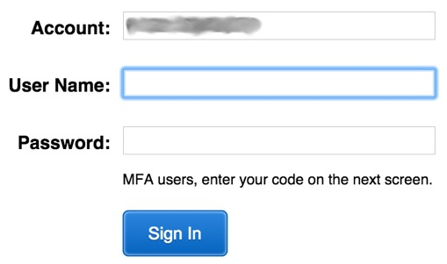

IAM MFA
MFA provides increased security.
In addition to username and password, MFA requires a unique authentication code to access AWS services.
Username and password
MFA token
AWS Management Console
Notes:
AWS services and resources can be accessed by using the AWS Management Console, the AWS CLI, or through SDKs and APIs. For increased security, we recommend enabling MFA.
With MFA, users and systems must provide an MFA token—in addition to the regular sign-in credentials—before they can access AWS services and resources.
Options for generating the MFA authentication token include virtual MFA-compliant applications (such as Google Authenticator or Authy 2-Factor Authentication), U2F security key devices, and hardware MFA devices.

Slide 32



Authorization: What actions are permitted
After the user or application is connected to the AWS account, what are they allowed to do?
EC2 instances
Full access
Read-only
IAM user, IAM group, or IAM role
S3 bucket
IAM policies
Notes:
Authorization is the process of determining what permissions a user, service or application should be granted. After a user has been authenticated, they must be authorized to access AWS services.
By default, IAM users do not have permissions to access any resources or data in an AWS account. Instead, you must explicitly grant permissions to a user, group, or role by creating a policy, which is a document in JavaScript Object Notation (JSON) format. A policy lists permissions that allow or deny access to resources in the AWS account.

Slide 33
IAM: Authorization
Assign permissions by creating an IAM policy.
Permissions determine which resources and operations are allowed:
All permissions are implicitly denied by default.
If something is explicitly denied, it is never allowed.
Best practice: Follow the principle of least privilege.
Note: The scope of IAM service configurations is global. Settings apply across all AWS Regions.
IAM permissions
Notes:
To assign permission to a user, group or role, you must create an IAM policy (or find an existing policy in the account). There are no default permissions. All actions in the account are denied to the user by default (implicit deny) unless those actions are explicitly allowed. Any actions that you do not explicitly allow are denied. Any actions that you explicitly deny are always denied.
The principle of least privilege is an important concept in computer security. It promotes that you grant only the minimal user privileges needed to the user, based on the needs of your users. When you create IAM policies, it is a best practice to follow this security advice of granting least privilege. Determine what users need to be able to do and then craft policies for them that let the users perform only those tasks. Start with a minimum set of permissions and grant additional permissions as necessary. Doing so is more secure than starting with permissions that are too broad and then later trying to lock down the permissions granted.
Note that the scope of the IAM service configurations is global. The settings are not defined at an AWS Region level. IAM settings apply across all AWS Regions.

Slide 34
IAM: Authorization
Assign permissions by creating an IAM policy.
Permissions determine which resources and operations are allowed:
All permissions are implicitly denied by default.
If something is explicitly denied, it is never allowed.
Best practice: Follow the principle of least privilege.
Note: The scope of IAM service configurations is global. Settings apply across all AWS Regions.
IAM permissions
Notes:
To assign permission to a user, group or role, you must create an IAM policy (or find an existing policy in the account). There are no default permissions. All actions in the account are denied to the user by default (implicit deny) unless those actions are explicitly allowed. Any actions that you do not explicitly allow are denied. Any actions that you explicitly deny are always denied.
The principle of least privilege is an important concept in computer security. It promotes that you grant only the minimal user privileges needed to the user, based on the needs of your users. When you create IAM policies, it is a best practice to follow this security advice of granting least privilege. Determine what users need to be able to do and then craft policies for them that let the users perform only those tasks. Start with a minimum set of permissions and grant additional permissions as necessary. Doing so is more secure than starting with permissions that are too broad and then later trying to lock down the permissions granted.
Note that the scope of the IAM service configurations is global. The settings are not defined at an AWS Region level. IAM settings apply across all AWS Regions.

Slide 35
IAM: Authorization
Assign permissions by creating an IAM policy.
Permissions determine which resources and operations are allowed:
All permissions are implicitly denied by default.
If something is explicitly denied, it is never allowed.
Best practice: Follow the principle of least privilege.
Note: The scope of IAM service configurations is global. Settings apply across all AWS Regions.
IAM permissions
Notes:
To assign permission to a user, group or role, you must create an IAM policy (or find an existing policy in the account). There are no default permissions. All actions in the account are denied to the user by default (implicit deny) unless those actions are explicitly allowed. Any actions that you do not explicitly allow are denied. Any actions that you explicitly deny are always denied.
The principle of least privilege is an important concept in computer security. It promotes that you grant only the minimal user privileges needed to the user, based on the needs of your users. When you create IAM policies, it is a best practice to follow this security advice of granting least privilege. Determine what users need to be able to do and then craft policies for them that let the users perform only those tasks. Start with a minimum set of permissions and grant additional permissions as necessary. Doing so is more secure than starting with permissions that are too broad and then later trying to lock down the permissions granted.
Note that the scope of the IAM service configurations is global. The settings are not defined at an AWS Region level. IAM settings apply across all AWS Regions.

Slide 36
IAM policies
An IAM policy is a document that defines permissions
Enables fine-grained access control
Two types of policies – identity-based and resource-based
Identity-based policies –
Attach a policy to any IAM entity
An IAM user, an IAM group, or an IAM role
Policies specify:
Actions that may be performed by the entity
Actions that may not be performed by the entity
A single policy can be attached to multiple entities
A single entity can have multiple policies attached to it
Resource-based policies
Attached to a resource (such as an S3 bucket)
IAM entities
Attach to one of
IAM user
IAM policy
IAM group
IAM role
Notes:
An IAM policy is a formal statement of permissions that will be granted to an entity. Policies can be attached to any IAM entity. Entities include users, groups, roles, or resources. For example, you can attach a policy to AWS resources that will block all requests that do not come from an approved Internet Protocol (IP) address range. Policies specify what actions are allowed, which resources to allow the actions on, and what the effect will be when the user requests access to the resources.
The order in which the policies are evaluated has no effect on the outcome of the evaluation. All policies are evaluated, and the result is always that the request is either allowed or denied. When there is a conflict, the most restrictive policy applies.
There are two types of IAM policies. Identity-based policies are permissions policies that you can attach to a principal (or identity) such as an IAM user, role, or group. These policies control what actions that identity can perform, on which resources, and under what conditions. Identity-based policies can be further categorized as:
Managed policies – Standalone identity-based policies that you can attach to multiple users, groups, and roles in your AWS account
Inline policies – Policies that you create and manage, and that are embedded directly into a single user group or role.
Resource-based policies are JSON policy documents that you attach to a resource, such as an S3 bucket. These policies control what actions a specified principal can perform on that resource, and under what conditions.

Slide 37

IAM policy example
{
"Version": "2012-10-17",
"Statement":[{
"Effect":"Allow",
"Action":["DynamoDB:*","s3:*"],
"Resource":[ "arn:aws:dynamodb:region:account-number-without-hyphens:table/table-name",
"arn:aws:s3:::bucket-name",
"arn:aws:s3:::bucket-name/*"]
},
{
"Effect":"Deny",
"Action":["dynamodb:*","s3:*"],
"NotResource":["arn:aws:dynamodb:region:account-number-without-hyphens:table/table-name”,
"arn:aws:s3:::bucket-name",
"arn:aws:s3:::bucket-name/*"]
}
]
}
Explicit allow gives users access to a specific DynamoDB table and…
…Amazon S3 buckets.
Explicit deny ensures that the users cannot use any other AWS actions or resources other than that table and those buckets.
An explicit deny statement takes precedence over an allow statement.
Notes:
As mentioned previously, IAM policy documents are written in JSON.
The example IAM policy grants users access only to the following resources:
The DynamoDB table whose name is represented by table-name.
The AWS account's S3 bucket, whose name is represented by bucket-name and all the objects that it contains.
The IAM policy also includes an explicit deny ("Effect":"Deny") element. The NotResource element helps to ensure that users cannot use any other DynamoDB or S3 actions or resources except the actions and resources that are specified in the policy—even if permissions have been granted in another policy. An explicit deny statement takes precedence over an allow statement.

Slide 38


Resource-based policies
Identity-based policies are attached to a user, group, or role
Resource-based policies are attached to a resource (not to a user, group or role)
Characteristics of resource-based policies –
Specifies who has access to the resource and what actions they can perform on it
The policies are inline only, not managed
Resource-based policies are supported only by some AWS services
AWS Account
IAM user MaryMajor
S3 bucket photos
attached
Defined inline
on the bucket
Identity-based policy
Resource-based policy
Policy grants list, read objects to the photos bucket
Policy grants user MaryMajor list, read objects
Notes:
While identity-based policies are attached to a user, group, or role, resource-based policies are attached to a resource, such as an S3 bucket. These policies specify who can access the resource and what actions they can perform on it.
Resource-based policies are defined inline only, which means that you define the policy on the resource itself, instead of creating a separate IAM policy document that you attach. For example, to create an S3 bucket policy (a type of resource-based policy) on an S3 bucket, navigate to the bucket, click the Permissions tab, click the Bucket Policy button, and define the JSON-formatted policy document there. An Amazon S3 access control list (ACL) is another example of a resource-based policy.
The diagram shows two different ways that the user MaryMajor could be granted access to objects in the S3 bucket that is named photos. On the left, you see an example of an identity-based policy. An IAM policy that grants access to the S3 bucket is attached to the MaryMajor user. On the right, you see an example of a resource-based policy. The S3 bucket policy for the photos bucket specifies that the user MaryMajor is allowed to list and read the objects in the bucket.
Note that you could define a deny statement in a bucket policy to restrict access to specific IAM users, even if the users are granted access in a separate identity-based policy. An explicit deny statement will always take precedence over any allow statement.

Slide 39
IAM permissions
How IAM determines permissions:
Is the permission explicitly denied ?
Is the permission explicitly allowed ?
No
No
Deny
Implicit deny
Yes
Yes
Deny
Allow
Notes:
IAM policies enable you to fine-tune privileges that are granted to IAM users, groups, and roles.
When IAM determines whether a permission is allowed, IAM first checks for the existence of any applicable explicit denial policy. If no explicit denial exists, it then checks for any applicable explicit allow policy. If neither an explicit deny nor an explicit allow policy exists, IAM reverts to the default, which is to deny access. This process is referred to as an implicit deny. The user will be permitted to take the action only if the requested action is not explicitly denied and is explicitly allowed.
It can be difficult to figure out whether access to a resource will be granted to an IAM entity when you develop IAM policies. The IAM Policy Simulator at https://docs.aws.amazon.com/IAM/latest/UserGuide/access_policies_testing-policies.html is a useful tool for testing and troubleshooting IAM policies.

Slide 40
IAM groups
An IAM group is a collection of IAM users
A group is used to grant the same permissions to multiple users
Permissions granted by attaching IAM policy or policies to the group
A user can belong to multiple groups
There is no default group
Groups cannot be nested
AWS account
IAM group:
Admins
IAM group:
Developers
IAM group:
Testers
Carlos Salazar
Li Juan
Zhang Wei
Márcia Oliveira
Mary Major
John Stiles
Richard Roe
Li Juan
Notes:
An IAM group is a collection of IAM users. IAM groups offer a convenient way to specify permissions for a collection of users, which can make it easier to manage the permissions for those users.
For example, you could create an IAM group that is called Developers and attach an IAM policy or multiple IAM policies to the Developers group that grant the AWS resource access permissions that developers typically need. Any user that you then add to the Developer group will automatically have the permissions that are assigned to the group. In such a case, you do not need to attach the IAM policy or IAM policies directly to the user. If a new user joins your organization and should be granted developer privileges, you can simply add that user to the Developers group. Similarly, if a person changes jobs in your organization, instead of editing that user's permissions, simply remove the user from the group.
Important characteristics of IAM groups:
A group can contain many users, and a user can belong to multiple groups.
Groups cannot be nested. A group can contain only users, and a group cannot contain other groups.
There is no default group that automatically includes all users in the AWS account. If you want to have a group with all account users in it, you need to create the group and add each new user to it.

Slide 41
IAM roles
An IAM role is an IAM identity with specific permissions
Similar to an IAM user
Attach permissions policies to it
Different from an IAM user
Not uniquely associated with one person
Intended to be assumable by a person, application, or service
Role provides temporary security credentials
Examples of how IAM roles are used to delegate access –
Used by an IAM user in the same AWS account as the role
Used by an AWS service—such as Amazon EC2—in the same account as the role
Used by an IAM user in a different AWS account than the role
IAM role
Notes:
An IAM role is an IAM identity you can create in your account that has specific permissions. An IAM role is similar to an IAM user because it is also an AWS identity that you can attach permissions policies to, and those permissions determine what the identity can and cannot do in AWS. However, instead of being uniquely associated with one person, a role is intended to be assumable by anyone who needs it. Also, a role does not have standard long-term credentials such as a password or access keys associated with it. Instead, when you assume a role, the role provides you with temporary security credentials for your role session.
You can use roles to delegate access to users, applications, or services that do not normally have access to your AWS resources. For example, you might want to grant users in your AWS account access to resources they don't usually have, or grant users in one AWS account access to resources in another account. Or you might want to allow a mobile app to use AWS resources, but you do not want to embed AWS keys within the app (where the keys can be difficult to rotate and where users can potentially extract them and misuse them). Also, sometimes you may want to grant AWS access to users who already have identities that are defined outside of AWS, such as in your corporate directory. Or, you might want to grant access to your account to third parties so that they can perform an audit on your resources.
For all of these example use cases, IAM roles are an essential component to implementing the cloud deployment.

Slide 42


Example use of an IAM role
Scenario:
An application that runs on an EC2 instance needs access to an S3 bucket
Solution:
Define an IAM policy that grants access to the S3 bucket.
Attach the policy to a role
Allow the EC2 instance to assume the role
AWS Cloud
Application has permissions to access the S3 bucket
Amazon EC2 instance
Application
3
Amazon S3 bucket photos
Role assumed by the EC2 instance
2
attached
IAM role
1
IAM policy grants access to photos bucket
Notes:
In the diagram, a developer runs an application on an EC2 instance that requires access to the S3 bucket that is named photos. An administrator creates the IAM role and attaches the role to the EC2 instance. The role includes a permissions policy that grants read-only access to the specified S3 bucket. It also includes a trust policy that allows the EC2 instance to assume the role and retrieve the temporary credentials. When the application runs on the instance, it can use the role's temporary credentials to access the photos bucket. The administrator does not need to grant the application developer permission to access the photos bucket, and the developer never needs to share or manage credentials.
To learn more details about this example, see Using an IAM Role to Grant Permissions to Applications Running on Amazon EC2 Instances at https://docs.aws.amazon.com/IAM/latest/UserGuide/id_roles_use_switch-role-ec2.html.

Slide 43
Section 4: Securing accounts
Module 4: AWS Cloud Security
Notes:
Introducing Section 4: Securing accounts

Slide 44

AWS Organizations
AWS Organizations enables you to consolidate multiple AWS accounts so that you centrally manage them.
Security features of AWS Organizations:
Group AWS accounts into organizational units (OUs) and attach different access policies to each OU.
Integration and support for IAM
Permissions to a user are the intersection of what is allowed by AWS Organizations and what is granted by IAM in that account.
Use service control policies to establish control over the AWS services and API actions that each AWS account can access
AWS Organizations
Notes:
AWS Organizations is an account management service that enables you to consolidate multiple AWS accounts into an organization that you create and centrally manage. Here, the focus is on the security features that AWS Organizations provides.
One helpful security feature is that you can group accounts into organizational units (OUs) and attach different access policies to each OU. For example, if you have accounts that should only be allowed to access AWS services that meet certain regulatory requirements, you can put those accounts into one OU. You then can define a policy that blocks OU access to services that do not meet those regulatory requirements, and then attach the policy to the OU.
Another security feature is that AWS Organizations integrates with and supports IAM. AWS Organizations expands that control to the account level by giving you control over what users and roles in an account or a group of accounts can do. The resulting permissions are the logical intersection of what is allowed by the AWS Organizations policy settings and what permissions are explicitly granted by IAM in the account for that user or role. The user can access only what is allowed by both the AWS Organizations policies and IAM policies.
Finally, AWS Organizations provides service control policies (SCPs) that enable you to specify the maximum permissions that member accounts in the organization can have. In SCPs, you can restrict which AWS services, resources, and individual actions the users and roles in each member account can access. These restrictions even override the administrators of member accounts. When AWS Organizations blocks access to a service, resource, or API action, a user or role in that account can't access it, even if an administrator of a member account explicitly grants such permissions.

Slide 45
AWS Organizations: Service control policies
Service control policies (SCPs) offer centralized control over accounts.
Limit permissions that are available in an account that is part of an organization.
Ensures that accounts comply with access control guidelines.
SCPs are similar to IAM permissions policies –
They use similar syntax.
However, an SCP never grants permissions.
Instead, SCPs specify the maximum permissions for an organization.
Notes:
Here is a closer look at the Service control policies (SCPs) feature of AWS Organizations.
SCPs offer central control over the maximum available permissions for all accounts in your organization, enabling you to ensure that your accounts stay in your organization’s access control guidelines. SCPs are available only in an organization that has all features enabled, including consolidated billing. See more on enabling features at https://docs.aws.amazon.com/organizations/latest/userguide/orgs_manage_org_support-all-features.html. SCPs aren't available if your organization has enabled only the consolidated billing features. For instructions about enabling SCPs, see Enabling and Disabling a Policy Type on a Root at https://docs.aws.amazon.com/organizations/latest/userguide/orgs_manage_policies.html#enable_policies_on_root.
SCPs are similar to IAM permissions policies and they use almost the same syntax. However, an SCP never grants permissions. Instead, SCPs are JSON policies that specify the maximum permissions for an organization or OU. Attaching an SCP to the organization root or an organizational unit (OU) defines a safeguard for the actions that accounts in the organization root or OU can do. However, it is not a substitute for well-managed IAM configurations within each account. You must still attach IAM policies to users and roles in your organization's accounts to actually grant permissions to them. See more on IAM policies at https://docs.aws.amazon.com/IAM/latest/UserGuide/access_policies.html.

Slide 46
AWS Key Management Service (AWS KMS)
AWS Key Management Service (AWS KMS) features:
Enables you to create and manage encryption keys
Enables you to control the use of encryption across AWS services and in your applications.
Integrates with AWS CloudTrail to log all key usage.
Uses hardware security modules (HSMs) that are validated by Federal Information Processing Standards (FIPS) 140-2 to protect keys
AWS Key Management Service (AWS KMS)
Notes:
AWS Key Management Service (AWS KMS) is a service that enables you to create and manage encryption keys, and to control the use of encryption across a wide range of AWS services and your applications. AWS KMS is a secure and resilient service that uses hardware security modules (HSMs) that were validated under Federal Information Processing Standards (FIPS) 140-2 (or are in the process of being validated) to protect your keys. AWS KMS also integrates with AWS CloudTrail to provide you with logs of all key usage to help meet your regulatory and compliance needs.
Customer master keys (CMKs) are used to control access to data encryption keys that encrypt and decrypt your data. You can create new keys when you want, and you can manage who has access to these keys and who can use them. You can also import keys from your own key management infrastructure into AWS KMS.
AWS KMS integrates with most AWS services, which means that you can use AWS KMS CMKs to control the encryption of the data that you store in these services. To learn more, see AWS Key Management Service features at https://aws.amazon.com/kms/features/.

Slide 47
Amazon Cognito
Amazon Cognito features:
Adds user sign-up, sign-in, and access control to your web and mobile applications.
Scales to millions of users.
Supports sign-in with social identity providers, such as Facebook, Google, and Amazon; and enterprise identity providers, such as Microsoft Active Directory via Security Assertion Markup Language (SAML) 2.0.
Amazon Cognito
Notes:
Amazon Cognito provides solutions to control access to AWS resources from your application. You can define roles and map users to different roles so your application can access only the resources that are authorized for each user.
Amazon Cognito uses common identity management standards, such as Security Assertion Markup Language (SAML) 2.0. SAML is an open standard for exchanging identity and security information with applications and service providers. Applications and service providers that support SAML enable you to sign in by using your corporate directory credentials, such as your username and password from Microsoft Active Directory. With SAML, you can use single sign-on (SSO) to sign in to all of your SAML-enabled applications by using a single set of credentials.
Amazon Cognito helps you meet multiple security and compliance requirements, including requirements for highly regulated organizations such as healthcare companies and merchants. Amazon Cognito is eligible for use with the US Health Insurance Portability and Accountability Act (HIPAA – see more on HIPAA at https://aws.amazon.com/compliance/hipaa-compliance/). It can also be used for workloads that are compliant with the Payment Card Industry Data Security Standard (PCI DSS – more on PCI DSS at https://aws.amazon.com/compliance/pci-dss-level-1-faqs/); the American Institute of CPAs (AICPA) Service Organization Control (SOC – more on SOC at https://aws.amazon.com/compliance/soc-faqs/); the International Organization for Standardization (ISO) and International Electrotechnical Commission (IEC) standards. More on ISO/IEC 27001 at https://aws.amazon.com/compliance/iso-27001-faqs/, ISO/IEC 27017 at https://aws.amazon.com/compliance/iso-27017-faqs/, and ISO/IEC 27018 at https://aws.amazon.com/compliance/iso-27018-faqs/; and ISO 9001 at https://aws.amazon.com/compliance/iso-9001-faqs/.

Slide 48
AWS Shield
AWS Shield features:
Is a managed distributed denial of service (DDoS) protection service
Safeguards applications running on AWS
Provides always-on detection and automatic inline mitigations
AWS Shield Standard enabled for at no additional cost. AWS Shield Advanced is an optional paid service.
Use it to minimize application downtime and latency.
AWS Shield
Notes:
AWS Shield is a managed distributed denial of service (DDoS) protection service that safeguards applications that run on AWS. It provides always-on detection and automatic inline mitigations that minimize application downtime and latency, so there is no need to engage AWS Support to benefit from DDoS protection.
AWS Shield helps protects your website from all types of DDoS attacks, including Infrastructure layer attacks (like User Datagram Protocol—or UDP—floods), state exhaustion attacks (like TCP SYN floods), and application-layer attacks (like HTTP GET or POST floods). For examples, see the AWS WAF Developer Guide at https://docs.aws.amazon.com/waf/latest/developerguide/waf-chapter.html.
AWS Shield Standard is automatically enabled to all AWS customers at no additional cost.
AWS Shield Advanced is an optional paid service. AWS Shield Advanced provides additional protections against more sophisticated and larger attacks for your applications that run on Amazon EC2, Elastic Load Balancing, Amazon CloudFront, AWS Global Accelerator, and Amazon Route 53. AWS Shield Advanced is available to all customers. However, to contact the DDoS Response Team, customers need to have either Enterprise Support or Business Support from AWS Support.

Slide 49
Section 5: Securing data on AWS
Module 4: AWS Cloud Security
Notes:
Introducing Section 5: Securing data on AWS

Slide 50




Encryption of data at rest
Encryption encodes data with a secret key, which makes it unreadable
Only those who have the secret key can decode the data
AWS KMS can manage your secret keys
AWS supports encryption of data at rest
Data at rest = Data stored physically (on disk or on tape)
You can encrypt data stored in any service that is supported by AWS KMS, including:
Amazon S3
Amazon EBS
Amazon Elastic File System (Amazon EFS)
Amazon RDS managed databases
Notes:
Data encryption is an essential tool to use when your objective is to protect digital data. Data encryption takes data that is legible and encodes it so that it is unreadable to anyone who does not have access to the secret key that can be used to decode it. Thus, even if an attacker gains access to your data, they cannot make sense of it.
Data at rest refers to data that is physically stored on disk or on tape.
You can create encrypted file systems on AWS so that all your data and metadata is encrypted at rest by using the open standard Advanced Encryption Standard (AES)-256 encryption algorithm. When you use AWS KMS, encryption and decryption are handled automatically and transparently, so that you do not need to modify your applications. If your organization is subject to corporate or regulatory policies that require encryption of data and metadata at rest, AWS recommends enabling encryption on all services that store your data. You can encrypt data stored in any service that is supported by AWS KMS. See How AWS Services use AWS KMS for a list of supported services at https://docs.aws.amazon.com/kms/latest/developerguide/service-integration.html.

Slide 51



Encryption of data in transit
Encryption of data in transit (data moving across a network)
Transport Layer Security (TLS)—formerly SSL—is an open standard protocol
AWS Certificate Manager provides a way to manage, deploy, and renew TLS or SSL certificates
Secure HTTP (HTTPS) creates a secure tunnel
Uses TLS or SSL for the bidirectional exchange of data
AWS services support data in transit encryption.
Two examples:
AWS Cloud
Corporate data center
AWS Cloud
TLS encrypted data traffic
TLS or SSL
encrypted
Amazon EC2
Amazon EFS
AWS Storage Gateway
Amazon S3
Notes:
Data in transit refers to data that is moving across the network. Encryption of data in transit is accomplished by using Transport Layer Security (TLS) 1.2 with an open standard AES-256 cipher. TLS was formerly called Secure Sockets Layer (SSL).
AWS Certificate Manager is a service that enables you to provision, manage, and deploy SSL or TLS certificates for use with AWS services and your internal connected resources. SSL or TLS certificates are used to secure network communications and establish the identity of websites over the internet, and also resources on private networks. With AWS Certificate Manager, you can request a certificate and then deploy it on AWS resources (such as load balancers or CloudFront distributions). AWS Certificate Manager also handles certificate renewals.
Web traffic that runs over HTTP is not secure. However, traffic that runs over Secure HTTP (HTTPS) is encrypted by using TLS or SSL. HTTPS traffic is protected against eavesdropping and man-in-the-middle attacks because of the bidirectional encryption of the communication.
AWS services support encryption for data in transit. Two examples of encryption for data in transit are shown. The first example shows an EC2 instance that has mounted an Amazon EFS shared file system. All data traffic between the instance and Amazon EFS is encrypted by using TLS or SSL. For further details about this configuration, see Encryption of EFS Data in Transit at https://docs.aws.amazon.com/whitepapers/latest/efs-encrypted-file-systems/encryption-of-data-in-transit.html.
The second example shows the use of AWS Storage Gateway, a hybrid cloud storage service that provides on-premises access to AWS Cloud storage. In this example, the storage gateway is connected across the internet to Amazon S3, and the connection encrypts the data in transit.

Slide 52
Securing Amazon S3 buckets and objects
Newly created S3 buckets and objects are private and protected by default.
When use cases require sharing data objects on Amazon S3 –
It is essential to manage and control the data access.
Follow the permissions that follow the principle of least privilege and consider using Amazon S3 encryption.
Tools and options for controlling access to S3 data include –
Amazon S3 Block Public Access feature: Simple to use.
IAM policies: A good option when the user can authenticate using IAM.
Bucket policies
Access control lists (ACLs): A legacy access control mechanism.
AWS Trusted Advisor bucket permission check: A free feature.
Notes:
By default, all Amazon S3 buckets are private and can be accessed only by users who are explicitly granted access. It is essential to manage and control access to Amazon S3 data. AWS provides many tools and options for controlling access to your S3 buckets or objects, including:
Using Amazon S3 Block Public Access. These settings override any other policies or object permissions. Enable Block Public Access for all buckets that you don't want to be publicly accessible. This feature provides a straightforward method for avoiding unintended exposure of Amazon S3 data.
Writing IAM policies that specify the users or roles that can access specific buckets and objects. This method was discussed in detail earlier in this module.
Writing bucket policies that define access to specific buckets or objects. This option is typically used when the user or system cannot authenticate by using IAM. Bucket policies can be configured to grant access across AWS accounts or to grant public or anonymous access to Amazon S3 data. If bucket policies are used, they should be written carefully and tested fully. You can specify a deny statement in a bucket policy to restrict access. Access will be restricted even if the users have permissions that are granted in an identity-based policy that is attached to the users.
Setting access control lists (ACLs) on your buckets and objects. ACLs are less commonly used (ACLs predate IAM). If you do use ACLs, do not set access that is too open or permissive.
AWS Trusted Advisor provides a bucket permission check feature that is a useful tool for discovering if any of the buckets in your account have permissions that grant global access.

Slide 53
Section 6: Working to ensure compliance
Module 4: AWS Cloud Security
Notes:
Introducing Section 6: Working to ensure compliance.

Slide 54



AWS compliance programs
Customers are subject to many different security and compliance regulations and requirements.
AWS engages with certifying bodies and independent auditors to provide customers with detailed information about the policies, processes, and controls that are established and operated by AWS.
Compliance programs can be broadly categorized –
Certifications and attestations
Assessed by a third-party, independent auditor
Examples: ISO 27001, 27017, 27018, and ISO/IEC 9001
Laws, regulations, and privacy
AWS provides security features and legal agreements to support compliance
Examples: EU General Data Protection Regulation (GDPR), HIPAA
Alignments and frameworks
Industry- or function-specific security or compliance requirements
Examples: Center for Internet Security (CIS), EU-US Privacy Shield certified
Notes:
AWS engages with external certifying bodies and independent auditors to provide customers with information about the policies, processes, and controls that are established and operated by AWS.
A full Listing of AWS Compliance Programs is available at https://aws.amazon.com/compliance/programs/. Also, for details about which AWS services are in scope of AWS assurance programs, see AWS Services in Scope by Compliance Program at https://aws.amazon.com/compliance/services-in-scope/.
As an example of a certification for which you can use AWS services to meet your compliance goals, consider the ISO/IEC 27001:2013 certification. It specifies the requirements for establishing, implementing, maintaining, and continually improving an Information Security Management System. The basis of this certification is the development and implementation of a rigorous security program, which includes the development and implementation of an Information Security Management System. The Information Security Management System defines how AWS perpetually manages security in a holistic, comprehensive manner.
AWS also provides security features and legal agreements that are designed to help support customers with common regulations and laws. One example is the Health Insurance Portability and Accountability Act (HIPAA) regulation. Another example, the European Union (EU) General Data Protection Regulation (GDPR) protects European Union data subjects' fundamental right to privacy and the protection of personal data. It introduces robust requirements that will raise and harmonize standards for data protection, security, and compliance. The GDPR Center at https://aws.amazon.com/compliance/gdpr-center/ contains many resources to help customers meet their compliance requirements with this regulation.

Slide 55
AWS Config
Assess, audit, and evaluate the configurations of AWS resources.
Use for continuous monitoring of configurations.
Automatically evaluate recorded configurations versus desired configurations.
Review configuration changes.
View detailed configuration histories.
Simplify compliance auditing and security analysis.
AWS Config
Example AWS Config Dashboard view
Notes:
AWS Config is a service that enables you to assess, audit, and evaluate the configurations of your AWS resources. AWS Config continuously monitors and records your AWS resource configurations, and it enables you to automate the evaluation of recorded configurations against desired configurations. With AWS Config, you can review changes in configurations and relationships between AWS resources, review detailed resource configuration histories, and determine your overall compliance against the configurations that are specified in your internal guidelines. This enables you to simplify compliance auditing, security analysis, change management, and operational troubleshooting.
As you can see in the AWS Config Dashboard screen capture shown here, AWS Config keeps an inventory listing of all resources that exist in the account, and it then checks for configuration rule compliance and resource compliance. Resources that are found to be noncompliant are flagged, which alerts you to the configuration issues that should be addressed within the account.
AWS Config is a Regional service. To track resources across Regions, enable it in every Region that you use. AWS Config offers an aggregator feature that can show an aggregated view of resources across multiple Regions and even multiple accounts.

Slide 56
AWS Artifact
Is a resource for compliance-related information
Provide access to security and compliance reports, and select online agreements
Can access example downloads:
AWS ISO certifications
Payment Card Industry (PCI) and Service Organization Control (SOC) reports
Access AWS Artifact directly from the AWS Management Console
Under Security, Identify & Compliance, click Artifact.
AWS Artifact
Notes:
AWS Artifact provides on-demand downloads of AWS security and compliance documents, such as AWS ISO certifications, Payment Card Industry (PCI), and Service Organization Control (SOC) reports. You can submit the security and compliance documents (also known as audit artifacts) to your auditors or regulators to demonstrate the security and compliance of the AWS infrastructure and services that you use. You can also use these documents as guidelines to evaluate your own cloud architecture and assess the effectiveness of your company's internal controls. AWS Artifact provides documents about AWS only. AWS customers are responsible for developing or obtaining documents that demonstrate the security and compliance of their companies.
You can also use AWS Artifact to review, accept, and track the status of AWS agreements such as the Business Associate Agreement (BAA). A BAA typically is required for companies that are subject to HIPAA to ensure that protected health information (PHI) is appropriately safeguarded. With AWS Artifact, you can accept agreements with AWS and designate AWS accounts that can legally process restricted information. You can accept an agreement on behalf of multiple accounts. To accept agreements for multiple accounts, use AWS Organizations to create an organization. To learn more, see Managing agreements in AWS Artifact at https://docs.aws.amazon.com/artifact/latest/ug/managing-agreements.html.

